Slide 1
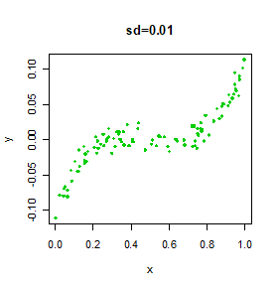
Effect of Standard Deviations
Scenario 3
Scenario 1
The difficulty of estimating f will depend on the standard deviation of the ε’s.
Scenario 4
Scenario 2
Notes:
Variance of the random error is called the irreducible error. We cannot do anything about the irreducible error. We hope that the irreducible error is small; meaning, we hope that the standard deviation of the random error is small. It will be challenging to estimate the true function when the irreducible error is big. To illustrate this issue, let us consider four scenarios when we have one x variable and one y variable.
(CLICK)(CLICK) In this first scenario, the standard deviation of the random error is very small, therefore, we do not see much spread in the data. We can visually see the shape of the true function. (CLICK)
(CLICK)(CLICK) In the second scenario, the standard deviation of the random error has increased, therefore, we see that the data is starting to spread out more. (CLICK)
(CLICK)(CLICK) In the third scenario, the standard deviation of the random error has increased further, therefore, we see that the data is even more spread out than the second scenario.(CLICK)
(CLICK)(CLICK) This is the last scenario with the highest standard deviation among the four scenarios. As a result, we see the most spread in the data. Among the four scenarios, we can expect that the estimated function to be most off from the true function in this scenario.

Slide 2
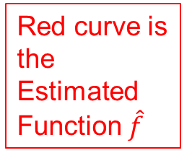
Different Estimates For f
Blue curve is the Unknown (True) Function f
Red curve is the Estimated Function $\hat{f}$
Notes:
Here we present the true function and the estimates of the true function for the four scenarios that we just saw. (CLICK)The true function is represented by the blue curve and (CLICK)the estimated functions are represented by the red curves. In the real life, the true function will be unknown. For demonstration purpose, we have simulated the data here by arbitrarily choosing a true function. You can see that all four scenarios have the same true function represented by the blue curves. As the standard deviation of the random error, i.e., irreducible error increases, the red curves are off from the blue curve. In fact, in the first scenario, the standard deviation of the random error is so small that red and blue curves overlap perfectly.

Slide 3
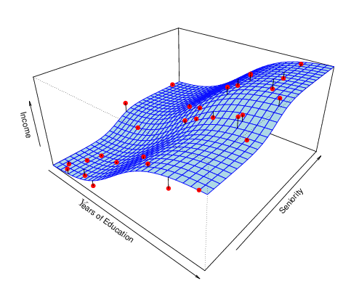
Challenges in Higher Dimension
Notes:
Irreducible error can be even more problematic when the data lives in higher dimensions. Here is an example with three dimensions. Let, Income be the y variable while Years of Education and Seniority are x variables. The blue surface is the true function and red dots are the data points. When the data spreads out more, there are many ways for the estimated function to be off from the true function. As a result, we are more likely to end up with an incorrect estimated function.
In the real world problems, we hope that the irreducible error is small.

